Slide 1
2024 Index of Pro Bono
More information at: https://pbi.trust.org

Slide 2
Summary of the sample
209 law firms
123 jurisdictions
Nearly 100,000 lawyers

Slide 3
Contents
Why do pro bono?
How should we structure our pro bono teams?
How should we incentivise pro bono?
Should we set pro bono targets?
How should we measure impact?

Slide 4
Why do pro bono?

Slide 5
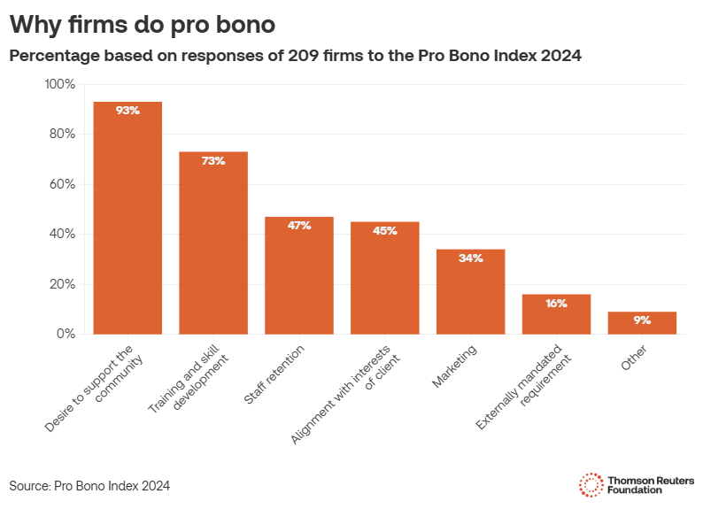
Why do pro bono?
The findings show a clear and growing recognition amongst law firms across the world that pro bono work is more than just altruism — it’s good for business.
Nearly three quarters of law firms (73%) reported using pro bono work as a tool to train and develop their staff.
Nearly half (47%) as a means to retain them.
Nearly half (45%) reported using pro bono to align with client interests.

Slide 6
How should we structure our pro bono teams?

Slide 7
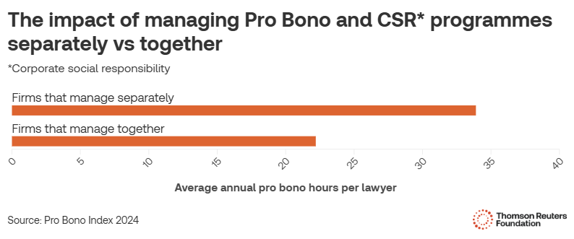
Structure
There is increasing evidence that separating Corporate Social Responsibility and Pro Bono programmes boosts productivity

Slide 8
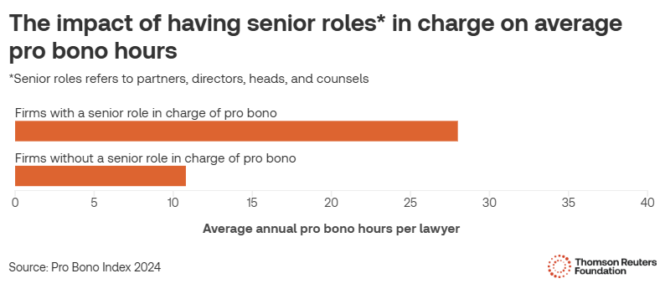
Structure
Having partner or senior-level buy-in has a tangible impact on the uptake of pro bono in firms

Slide 9
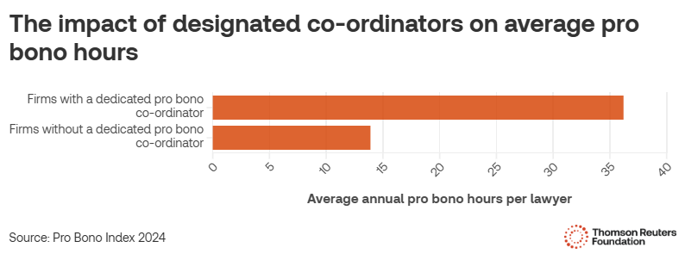
Structure
…as does installing a dedicated coordinator to manage your firm’s day-to-day pro bono work

Slide 10
How should we incentivise pro bono?

Slide 11
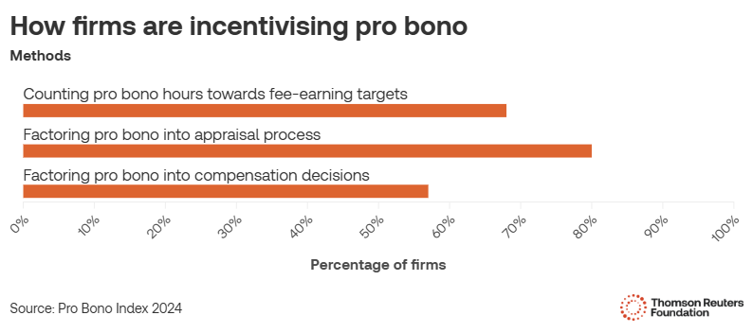
Incentivising pro bono
Firms are adopting multiple tactics to incentivise pro bono work –counting pro bono hours towards fee-earning targets, factoring it into compensation decisions or appraisal processes.

Slide 12
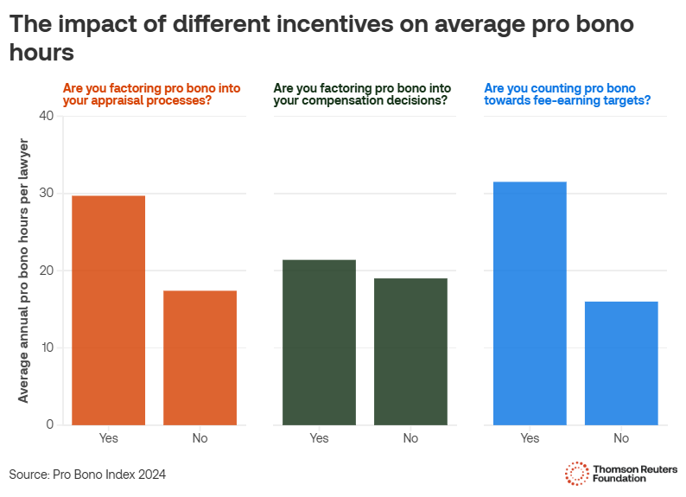
Incentivising pro bono
In all cases, incentives drive more pro bono hours.
But counting pro bono hours towards fee-earning targets is most effective.

Slide 13
Should we set pro bono targets?

Slide 14
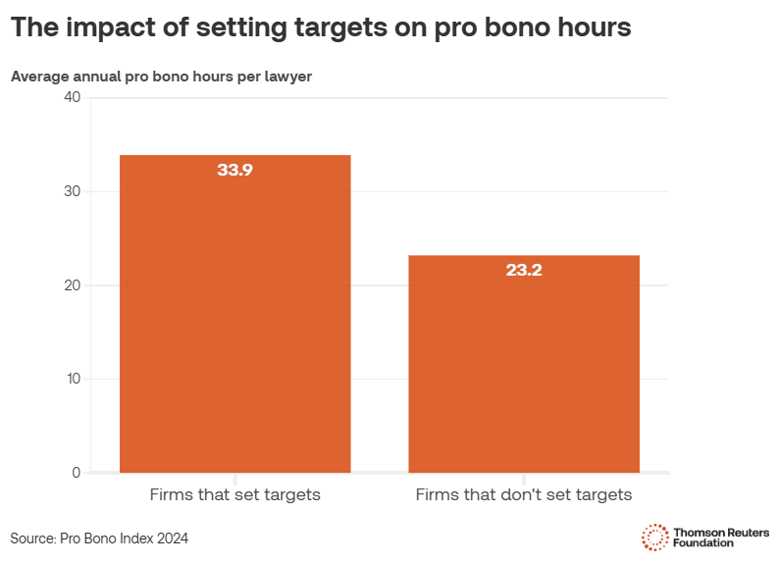
Setting targets
A significant number of firms are setting specific targets for pro bono hours.
Firms that do, log more hours.

Slide 15
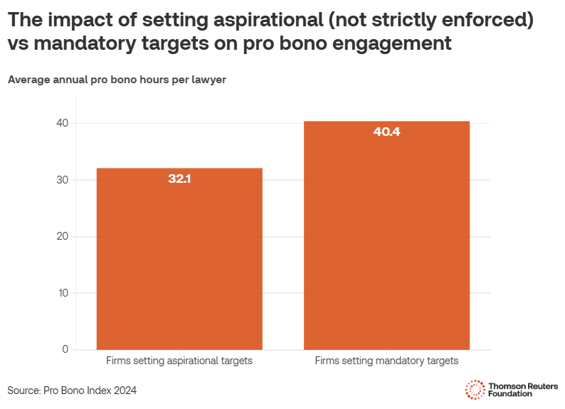
Setting targets
Mandatory (strictly enforced) targets drive significantly more engagement, compared to those that are aspirational (actively encouraged).
The average firm target for pro bono is 30 hours.

Slide 16
How should we measure impact?

Slide 17
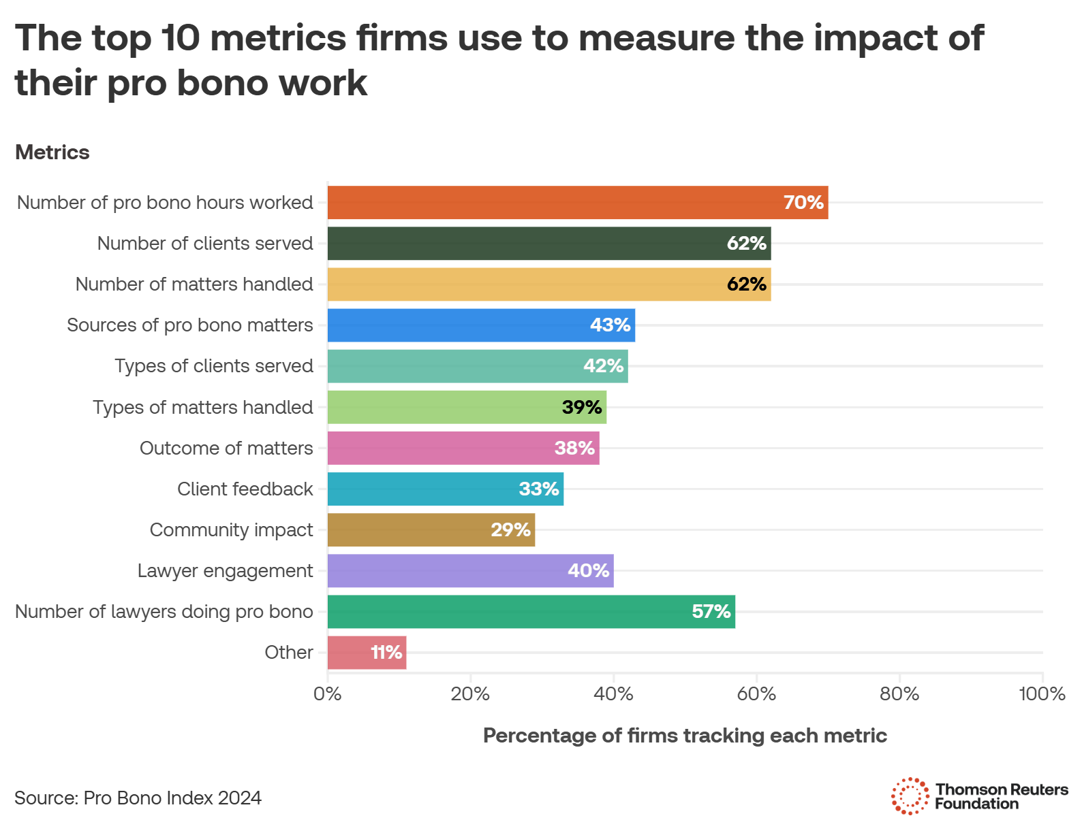
Measuring impact
Firms are favouring numerical measurements of their impact.
But they risk missing the full picture.

Slide 18

Measuring impact
Industry best practice for impact measurement suggests qualitative data collection is essential, as numbers cannot fully capture whether an intervention had a positive outcome for clients.
Download TrustLaw’s new Measuring Pro Bono Impact Guide for a roadmap of how to more effectively measure the impact of your pro bono projects.

Slide 19
About the Thomson Reuters Foundation
We are the corporate foundation of Thomson Reuters, the global news and information services company.
Established in 1982, the Foundation has 100 staff members in 17 locations around the world, and works to advance media freedom, raise awareness of human rights issues, and develop initiatives to support more inclusive economies.
We believe in the power of information and collaboration to shape a more fair and equal world. Through global news coverage, media development, free legal assistance and our convening authority, we seek to inform, connect and empower people around the world.
Our mission is to inspire collective leadership by building global awareness of the challenges facing humanity, and empowering others to shape free, fair and open societies.

